Slide 1
ORANGE HIGH SCHOOL NJROTC
Advisory Committee

Slide 2
INTRODUCTIONS

Slide 3
Roster and Unit Changes
The cadet roster will increase from 87 cadets to 110
Cadets take PE, health and wellness, and first aid in Naval Science
Naval Science I
17 cadets in 9th grade (10 males, seven females)
Naval Science II
31 cadets in 10th grade (12 males, 19 females)
Naval Science III
29 cadets in 11th grade (15 males, 14 females)
Naval Science IV
13 cadets in 12th grade (7 males, six females)

Slide 4
Enrollment Eligibility Requirements
Be enrolled in and attend a regular course of instruction in grade 9 through 12.
Be physically qualified to participate fully in the physical education program of the host school. Physicals are required and will be done with fall sports.
Be selected by the NJROTC instructor with the approval of the school principal or his/her representative.
Maintain acceptable academic achievement standards and an academic standing that warrants at least normal progression leading to graduation.
Maintain acceptable standards of conduct.
Comply with specified personal grooming standards. Common sense and good judgment apply to the attainment of these standards. Standards will not be relaxed so as to reflect discredit upon the naval service.

Slide 5
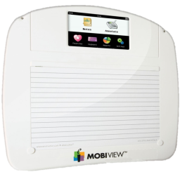
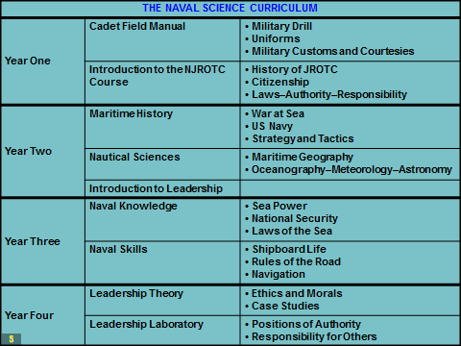
The Naval Science Curriculum

Slide 6
Operating our Program
Five classes daily for Naval Science I, II, III and IV cadets.
Cadets are required by the Navy to wear the NJROTC issued uniform once a week. We wear it on Wednesday.
Our Annual Military Inspection (AMI) is conducted by the Navy Area 4 Manager (Commander Jimmie Miller) in January. This inspection evaluates every area of the program and determines future NJROTC eligibility. Our inspection this year is Friday, January 27th. Please attend if possible.
PLAN of the WEEK is posted for cadets weekly.

Slide 7
EVENTS
Summer Leadership Program
Superintendent’s Forum – Cadets from the NJROTC summer leadership program demonstrated military drill and Color Guard to begin the school year for all district staff and teachers.
Navy Ball at Bella Italia Restaurant. A formal ceremony that includes etiquette and tradition. (Nov 9th)
Orange Veteran’s Day Parade (Nov 13th)
Annual Military Inspection (AMI) January 27th, 2022.

Slide 8
TEAMS & COMPETITIONS
Drill Team. Meets after school Tuesday, Wednesday, and Thursday in the gym. Team leaders meet on Monday and review the practice for the week.
Physical Fitness Team. The team will compete in physical fitness competitions against other schools with NJROTC programs.
Academic Team. Will compete in academic competitions against other schools with NJROTC programs.
Navy Night PT “Postal” competition “Are you ready for some football?”

Slide 9
Meeting Focus
Guest speaker recommendations and opportunities
Field trip recommendations, chaperones, and opportunities
Job shadowing
Supplies, equipment, fundraising suggestions

Slide 11
QUESTIONS?

